Slide 1
Stress Management and
Productivity
By Group 2

Slide 2
Stress
Stress is a very common and universal problem. People from almost every background experience stress, which is common but this is a really serious issue and it needs to be addressed because there are many diseases connected with stress.
In an organization Employers nowadays are closely examining the problems with stress management that lead to decreased work performance among employees, which originates from unhappiness and high turnover.

Slide 3
Common Symptoms of Stress at Workplace
Frequent headaches
Neck ache and back pain
Frequent colds
Anxiety and nervousness
Depression
Mood swings
Insomnia
Difficulty in concentrating
Trouble learning
Difficulty making decisions
Increased frustration
Reduced work efficiency or productivity
Excessive defensiveness
Problems communicating
Weight gain
Increased smoking or alcohol

Slide 4
Problem Statement
An organization's capacity to function may be significantly impacted by excessive workplace stress, which will have a negative effect on its bottom line. Here are a few ways stress may specifically hurt your company.
Effects of stress on businesses:
Reduced productivity
Decline in employee health
Frequent absenteeism
Higher employee turnover rate
Increased recruitment costs

Slide 5
Need
With this initiative, our main objective is to raise employee motivation and lower stress levels, which will help raise productivity.
We also need a digital platform that gives employees of business access to management awareness.
In order for employees to balance their personal and professional life.

Slide 6
Root Cause Analysis
Physical analysis
Organizational analysis
Social impact analysis
Human analysis
Mental impairment
Economical issues

Slide 7
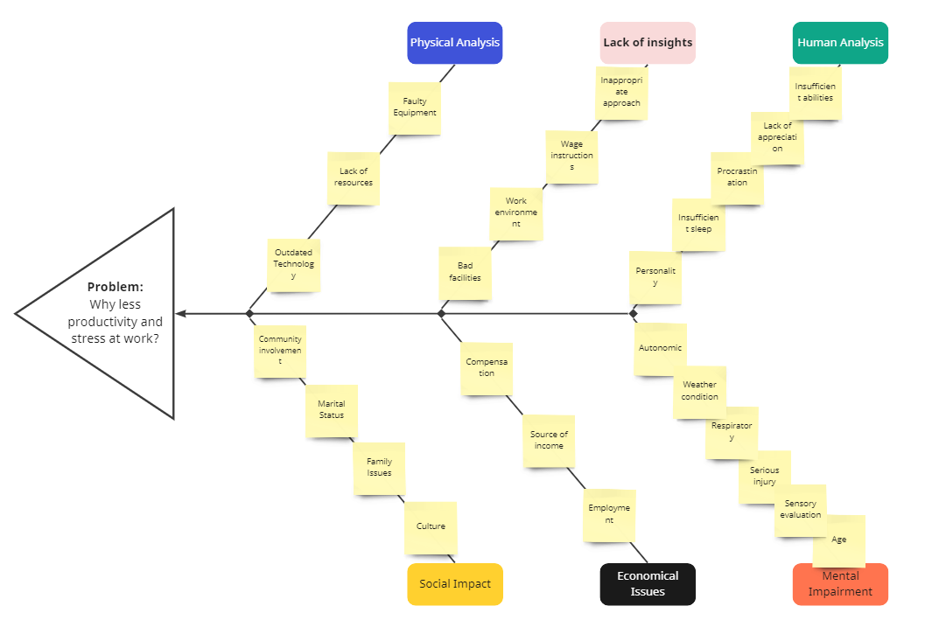
Fishbone Diagram

Slide 8
Current State
Corporate organizational stakeholders identified that the company’s production is decreasing caused of an unbalanced management structure, lack of resources, and demotivated staff.

Slide 9
Future State
The future state is to implement a new management system which requires more IT solutions. In this case, strict deadlines must follow which allows organizations to complete this process in the expected timeline.

Slide 10
Stakeholders
Steering Committee(Manager)
IT Department
Sponsors
Project Manager
Resource Manager
Executives
Company Owners
Analysis Team
Organizational Client
Finance Team
Human Resources(HR)
Operation Team
Marketing Team
Specialists (For Training)
Team Members
Senior Management
Government
Help Desk
System Admin

Slide 11
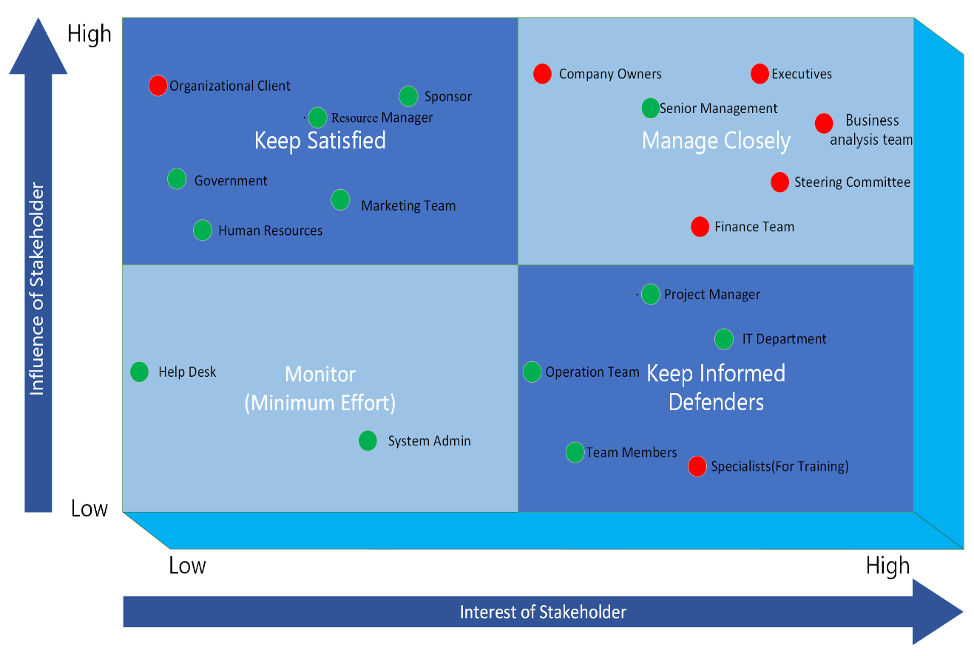
Stakeholder Metrix

Slide 12
Elicitation
Business Objectives
Stakeholders Meeting
Locations
Techniques
Discussion

Slide 13
Elicitation Requirements
Interviews:
In this case, the stakeholders are as followed: The Business Analyst (Interviewer) and Organizational Client (Interviewer).
A combination of structured and unstructured interview:
What makes your work environment different than other organizations?
How often do you feel stressed at your work?
Do you think you have enough numbers of employees?
How often do you provide training to your employees?
Goal: The purpose of this interview is to gather fundamental data about your business and
workplace.

Slide 14
Document Analysis
Personal documents:
Personal documents are records of a person’s own experiences. Examples include logs, journals, emails, social media posts, and blogs.
Public records:
The official, ongoing records of an organization’s activities are known as public records. Such as mission and statements, yearly reports, policy guides, and strategy plans.

Slide 15
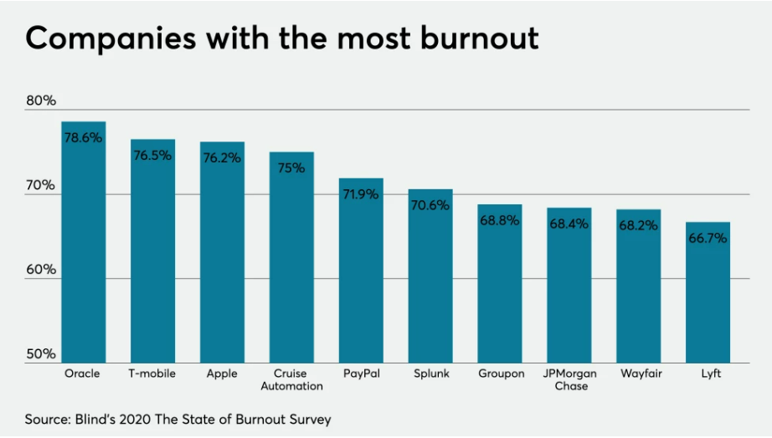
10 companies with the worst employee burnout

Slide 16
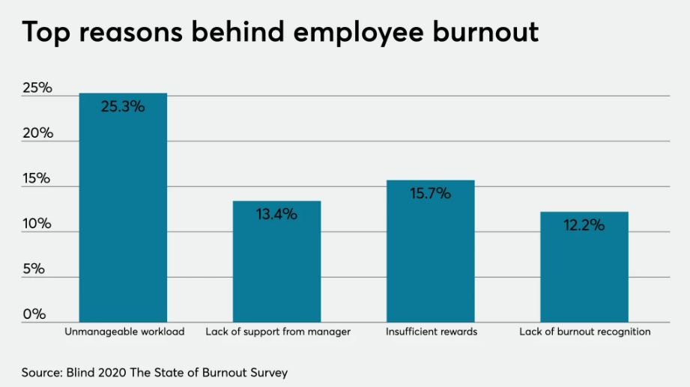
Reasons for burnout

Slide 17
Possible Solutions
Develop an online platform to provide training on transformation to the employees of client organizations
Specialists will be involved in client organization to fix the current system and maintain workflow and also specialists will deliver knowledge of management to the employee and motivate them.
Develop an application as well to track their activities and detect problems after training.

Slide 18
Value
Benefits
Systematic workflow
Increased productivity
Improved employees’ management skills and social life
Improved working pattern
Decreased project failure risk.

Slide 19
Cost
Timeline
IT support
Consulting
Physical resources
Information resources
Design
Installation
Maintenance
Operational
Application Subscription

Slide 20
Thank You!

Slide 21
“The greatest weapon against stress is our ability to choose one thought over another.” - William James

